Slide 1

“Inventory Management System”

Slide 2



Project Submitted By
Md Sahadat Husain
Md. Mayruful Haque
Md. Mahdi Tarafder
ID: 1812020153
ID: 1812020139
ID: 1812020137

Slide 3

Project Supervised By
Adil Ahmed Chowdhury
Lecturer
Department of Computer Science & Engineering ,
Leading University

Slide 4

Outline
Introduction
Motivation
Project Objectives
Language and Tools
Project Features
ER Diagram
Use Case Diagram
Future Plan
Conclusion

Slide 5
Introduction
Inventory Management System?
User of IMS?

Slide 6
Motivation
Why did we choose Inventory Management System ?
What is the difference between our project and other available options?

Slide 7
Project Objectives
Better Inventory Management
Better Security
Quick Payments
Simple Invoicing
Restrict access to store systems
Better Employee Management
Fewer Errors and Increased Efficiency
Better Customer Management and Promotion
Better Purchasing and Supplier Order Management
To make a communication system with all users

Slide 8
Languages & Tools
Languages:
Tools:
PHP
Laravel
Javascript
Jquery
Ajax
HTML
CSS 3
Bootstrap
MySQL
Xampp
VS Code
Sublime text
Mozilla Firefox/Google Chrome

Slide 9
Project Features
Invoice Management
View, Approval, Print, Daily Invoice report
Chat Messenger
Individual, Group, Public
Employee Management
Types, Registration, Salary, Attendance, Leave, Monthly Salary
User Management
View, Add, Approve, Edit
Suppliers Management
View, Add, Edit, Delete
Category and Unit Management
View, Add, Delete

Slide 10
Project Features
Product Management
View, Add, Edit, Delete
Supplier Purchasing
View, Add, Approve, Daily report
Customer Management
View, Add, Edit, Credit, Paid, Report
Stock Management
Stock Report, Custom Report
Expenditure Management
Add Cost, Edit Cost
Notice

Slide 11
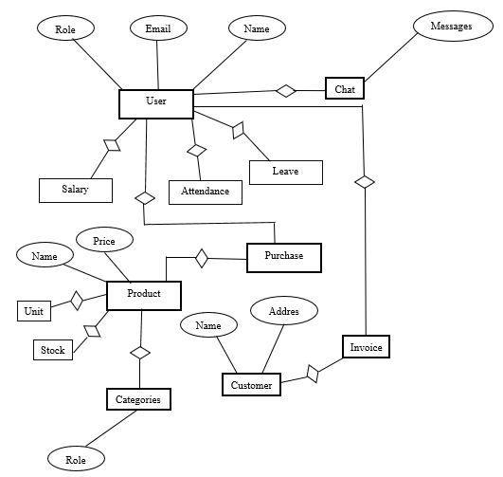
ER Diagram
Fig : ER Diagram

Slide 12
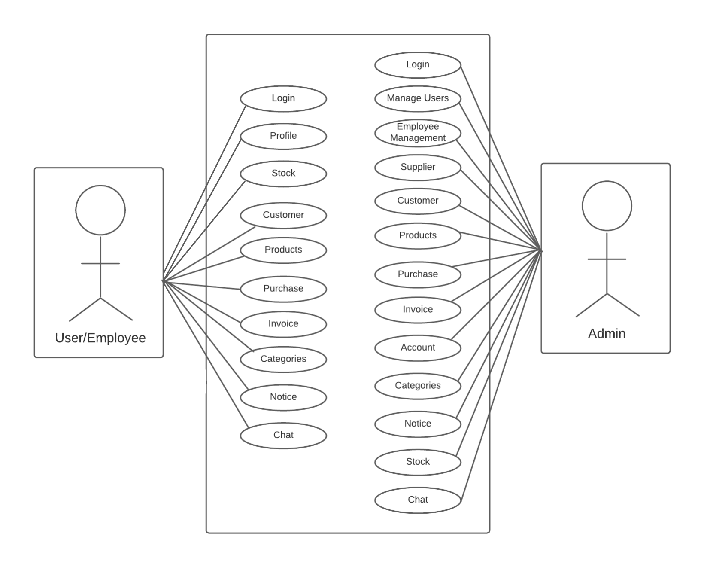
Use Case Diagram
Fig : Use Case Diagram

Slide 13

Future Plan
Adoptions of cloud technology.
API implement.
Payment Gateway.
Artificial intelligence.
Barcode scanner.
Looking ahead to the future.

Slide 14
Conclusion
It has been a great pleasure for us to work on this exciting and challenging project. This project proved good for us as it provided practical knowledge, also about all handling procedure related with “Inventory Management System”.

Slide 15


